Slide 1
Prototype Demonstration
Key Use Cases
January 19, 2016
CONFIDENTIAL DRAFT, for internal discussion only.

Slide 2

L1P - Reference Model
Lower Income Consumers
Lower Income Consumers
The Level One Project Guide
Agents
Digital Financial Services Providers
National Digital Financial Services System
Digital Financial Services Providers
Agents
Account Opening Service
Interoperability Service for Transfers
Account Opening Service
Consumer Account Management
Fraud and Risk
Management Service
Consumer Account Management
Small Payees
(Merchants
Schools
Clinics)
Small Payees
(Merchants
Schools
Clinics)
Agent and Merchant Account Management
Higher Income Consumers
Higher Income Consumers
Large Payees
(Merchants
Utilities Hospitals)
Card Networks
Large Payees
(Merchants
Utilities Hospitals)
ACH
RTGS
Retail and Commercial Banks
Retail, Commercial, and Settlement Banks
Large Payers
(Governments Employers
NGOs)
Large Payers
(Governments Employers
NGOs)
Central Bank

Slide 3
L1P – Component Map
Users
Edge: “Retail” Services
Center: L1 Shared Services
Edge: “Retail” Services
Users
MFSP Platform
Merchant Acquiring Processor
Bulk Payment Processor
MFSP Platform
Consumers
Enrollment and ID
Enrollment of
Merchants
Fraud Screening and
Fraud Analytics
Transaction Engine
Enrollment Mgmt.
Enrollment and ID
Consumers
Accounting
Invoice Generation
Funds Sweep
IST Gateway
Pmt. Batch Proc.
Accounting
Payments
Authentication
Merchant Reporting
POS Gateway
Pmt. Tx & Rcv.
Payments
Agents
Authentication
Interchange & fees calculation
Proximity Payment
Technology
Reconcile & Report
Authentication
Agents
UX Client and Comm
Fraud Monitoring and Risk Analytics
UX Client and Comm
Fraud Screening: KYC, AML, CFT
IST Gateway
Data Ingestion
Suspect Detection
New Pattern Mining
Fraud Screening: KYC, AML, CFT
Merchants
Fraud Analytics
Interoperability Service for Transfers
Fraud Analytics
Merchants
Agent Mgmt.
Enrollment of
Intermediaries
Authentication of Intermediaries
Fraud Analytics
Fraud Screening: KYC, AML, CFT
Agent Mgmt.
Schools
Liquidity Mgmt.
Payment Engine
Fees and Commissions
Routing
Clearing and Settlement
Liquidity Mgmt.
Schools
Message Proc. and
IST Gateway
Message Proc. and
IST Gateway
Message Proc. and
IST Gateway
Utilities and Other Consumer Billers
New Innovative Services
Level One API/Standards
New Innovative Services
Utilities and Other Consumer Billers
Message Protocols
Security
Integration
Lending
Lending
Government Agencies
Wealth Mgmt.
Center: Not L1 Shared Services
Wealth Mgmt.
Government Agencies
Etc.
New Innovative Services
Etc.
Credit Scoring
Escrow
Etc.
International
Agencies
Traditional Financial System
International
Agencies
Wholesale Trust Banks
(Used by MFSPs)
Commercial Banks
Reserve Bank Services
Employers
Intl. Remittance Services
ACH, RTGS, etc.
Employers
Regulation
Card Networks
Currency

Slide 4
L1P - Principles
First Principles:
Digital
Robust
Open
Affordable
Personal
Convenient
Secure
L1P Platform
Principles:
Prefunded Accounts
Tiered KYC/Self-Issued Accounts
Push Payment Model
Immediate Funds Transfer
Irrevocability
Open Loop Scheme
System-Wide Fraud and Risk Management
High Volume-Low Value Payments
Meet User
Demand For:
Easy Account Opening
Access to CICO
Safe Keeping of Stored Value
Person to Person Transfers
Direct Deposit Benefit Payments
Direct Deposit Wages
Purchase Goods
Transparent and Low Fees

Slide 5
The Journey
1
2
3
Vision
Enabled by a Set of First Principles
User Driven Demand for:
Enable the economic stability and prosperity of unbanked low income people through access to appropriate financial services leading to an inclusive digital economy
Digital
Robust
Open
Affordable
Personal
Convenient
Secure
Easy Account Opening
Access to CICO
Safe Keeping of Stored Value
Transfers to Other Individuals
Direct Deposit Benefit Payments
Direct Deposit Wages
Purchase Goods
Transparent and Low Fees
4
5
6
Design Principles for a Modern DFS Platform
Solution Sets that Enable Use Cases
A National Strategy for Financial Inclusion is More than Technology
Prefunded
Tiered KYC/Self-Issued Accounts
Push Payment Model
Immediate Funds Transfer
Irrevocability
Open Loop Scheme
System-Wide Fraud and Risk Management
High Volume-Low Value Payments
Account Opening Service
Consumer and Agent Account Service
Merchant Account Management
Interoperability Service for Transfers
Fraud and Risk Management Services
Technology
Regulatory Framework
Business Models
Scheme Rules
Governance
Operations
Communications

Slide 6
Investment Roadmap
Apps
Innovation Market for Value Added Services & Products
Enable market ecosystem innovation that delivers affordable, effective pro-poor services and products
Interventions: APIs and software library for developers to build, offer and deploy applications
Accounts
Digital Accounts & Transactions
Enable account opening and manage accounts for consumers, agents , merchants and payees
Interventions: APIs and software library for IST integration, vendor certification, selection, SLAs
Rails
Infrastructure for Connectivity & Interoperability
Define requirements, buy/build IST and Fraud Risk solutions
Interventions: Requirements and build/buy IST, Requirements build/buy fraud system, API library, vendor, provider, operator SLAs
Rules
Regulatory and Governance Framework
Establish Legal and Regulatory Framework to initiate and sustain digital financial services scheme and platform
Interventions: Create and guide mechanisms for rule setting, stakeholder collaboration, governing and operating the DFS scheme, participants and performance

Slide 7
PROTOTYPE DEMONSTRATION
Bulk Payments
Manage My Account
Send Money to Anyone
Buy Goods
Keep Money Secure
Agent Transactions
Agent Management
Deep Dive on Bulk
Requirements
Test Cases
APIs

Slide 8
BULK PAYMENTS
Send and Review
Distributed Authority
Funds Reservation
Vouchers
Funds Reservation Report
Deep Dive on Bulk
Requirements
Test Cases
APIs

Slide 9
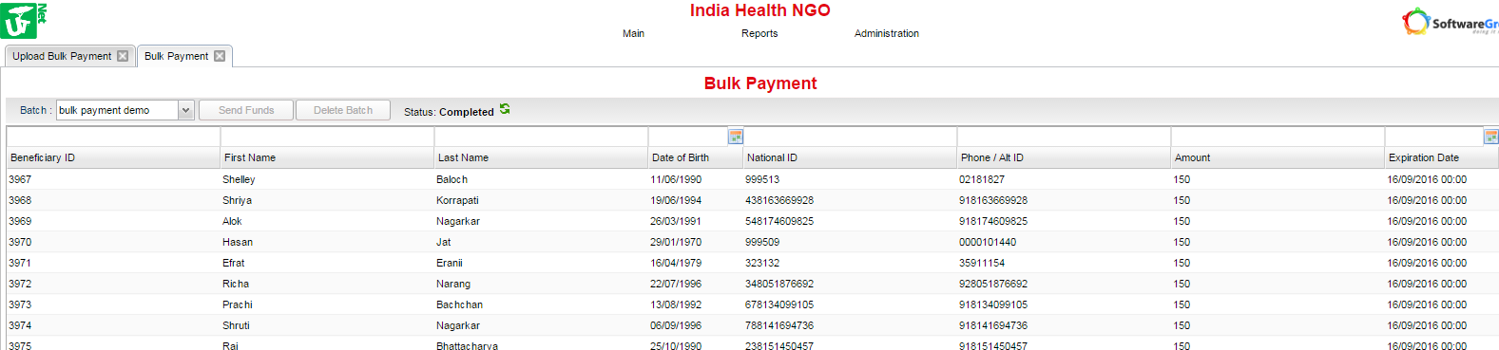
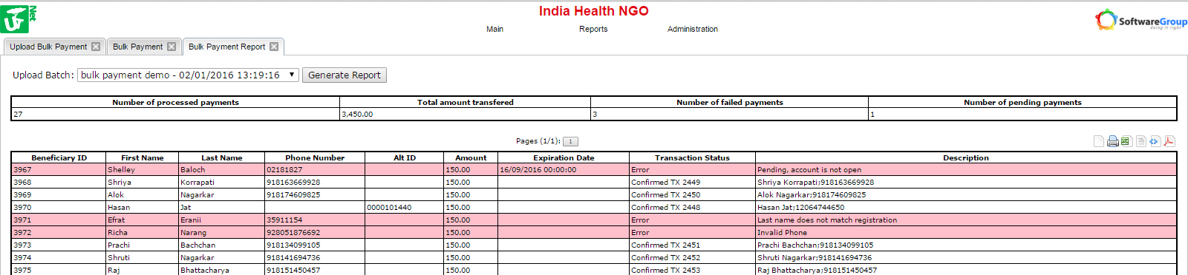
BULK PAYMENTS – Send and Review
Send one bulk payment file through IST that can go recipients on any DFSP
Data match criteria would be determined by payer
Delivery attempts continue until expiration date
Report header summarizes key data
Recipients who do not have an account will be prompted to open one
Specific error codes to guide follow-up data cleansing
Informative texts to users to notify them of payments and to suggest account opening
“You have received a payment of 150 from India Health NGO”
“You have pending payment of 150 from India Health NGO. Dial *105# to open mobile account and receive the money”

Slide 10
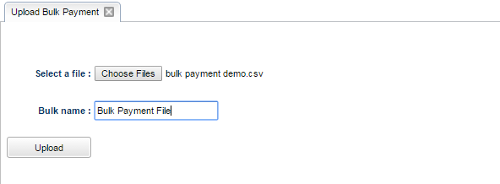
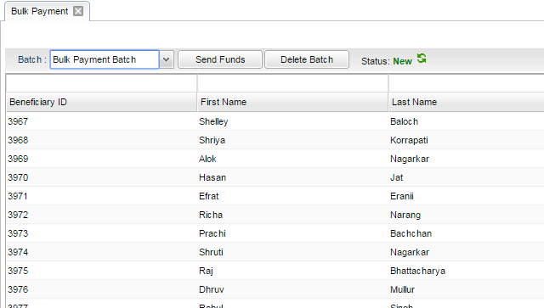
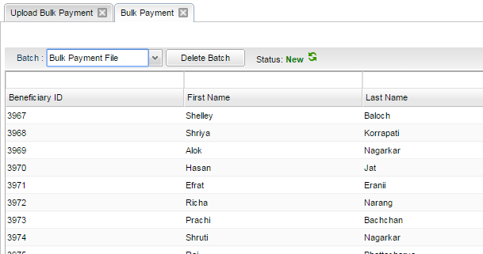
SEND BULK PAYMENTS – Distributed Authority
Logged in as “Maker” role
Logged in as “Checker” role
Maker role uploads bulk payment file (comma separated variable type)
Checker role sends for distribution, but cannot upload bulk payment files to the system
Maker role can review and delete files, but cannot execute payment

Slide 11
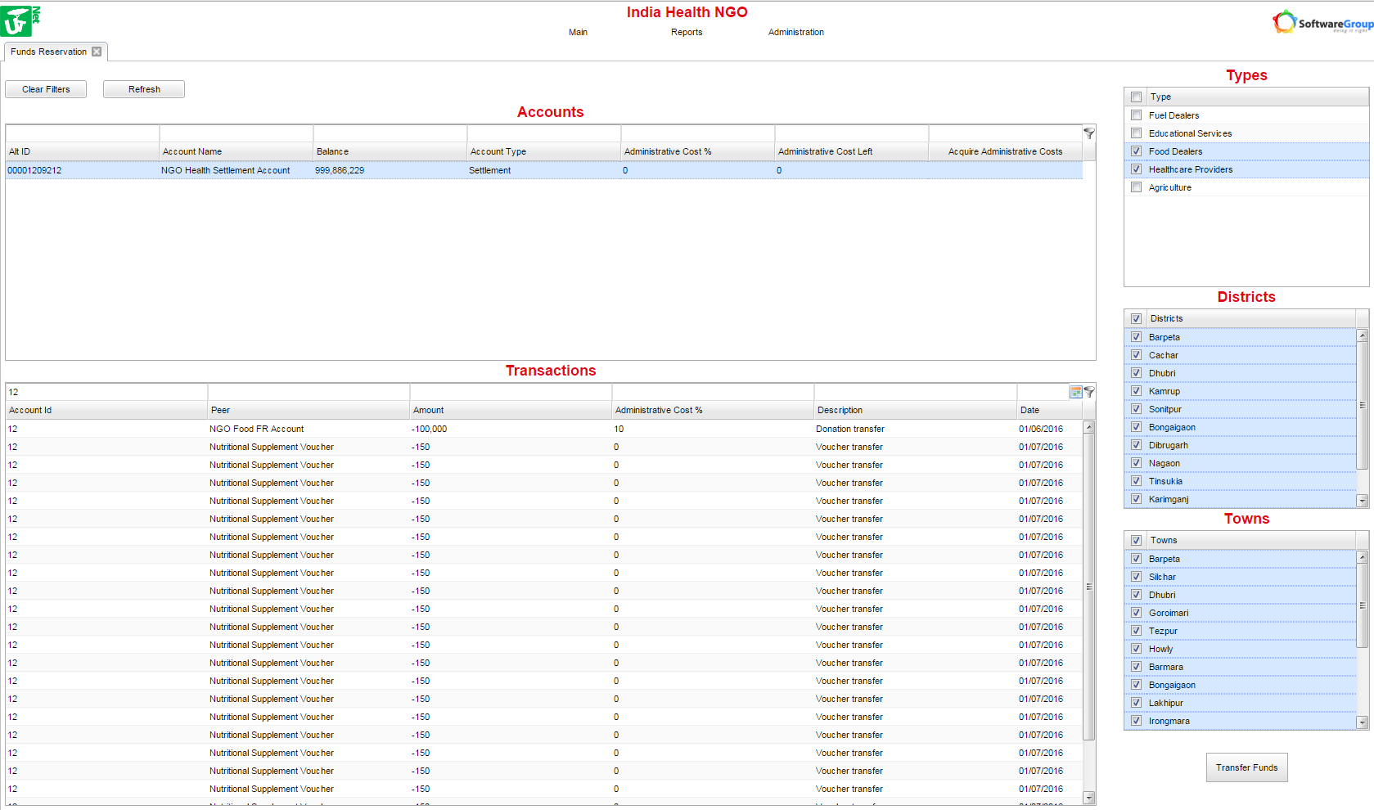
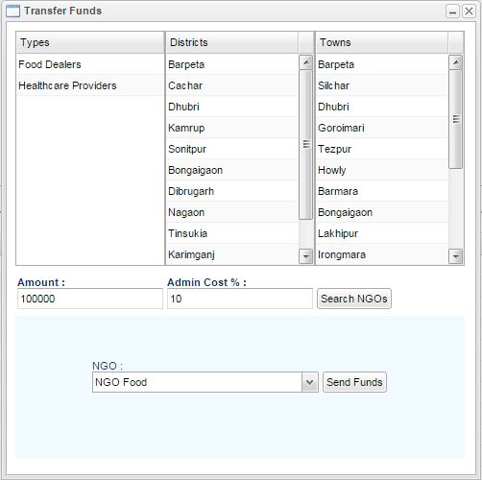
BULK PAYMENTS – Funds Reservation
Send funds from settlement account to another organization or payer
Set restriction criteria for merchant types and merchant locations where funds can be redeemed as vouchers
Review restriction criteria
Specify transfer amount and upper limit that receiving organization can extract for administrative costs
Search for organizations in the system that work with specified merchant types and work in specified locations

Slide 12
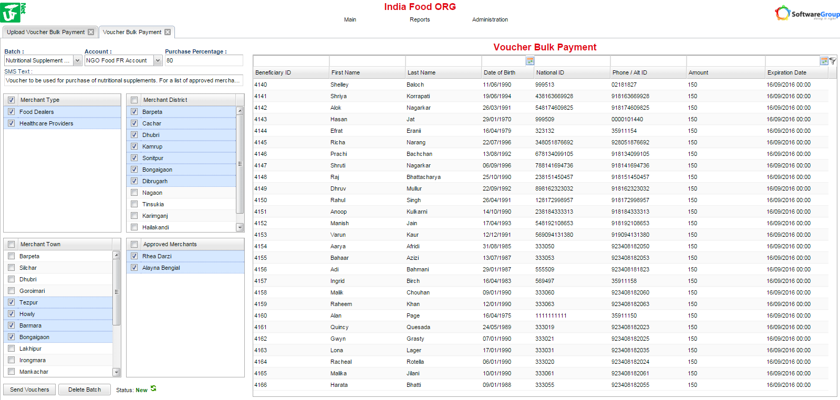
BULK PAYMENTS – Vouchers
Fund vouchers from Settlement Account or Funds Reservation account
Specify purchase percentage that voucher will cover
“Voucher to be used for purchase of nutritional supplements. For a list of approved merchants please call 923408182063”
Select approved merchants where vouchers will be redeemable
Merchant types and locations are pre-filtered based on restrictions made by organization that funded Funds Reservation account

Slide 13
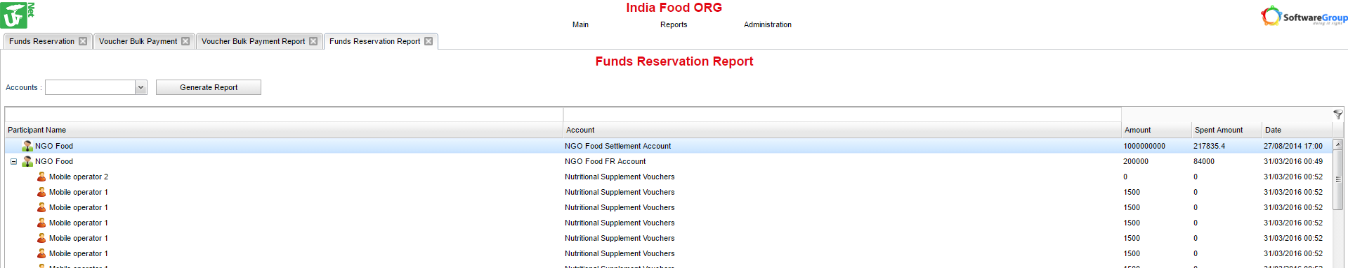
BULK PAYMENTS - Funds Reservation Report
Donor Organization has visibility to where their money was spent
Individual beneficiary ID’s are hidden to maintain confidentiality
Individual vouchers purchases and unredeemed value are visible

Slide 14
MANAGE MY ACCOUNT
Self Issue My Account
Open a Sub-Account
Close a Sub-Account
Add a User
Remove a User
Rename an Account
Change Primary Account

Slide 15
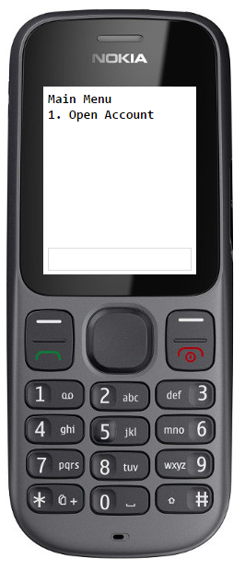
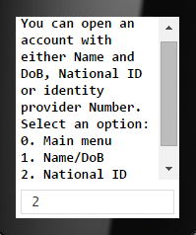
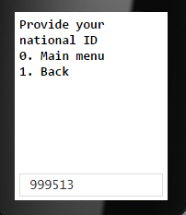
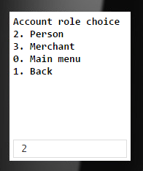
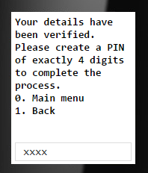
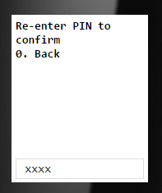
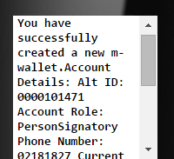
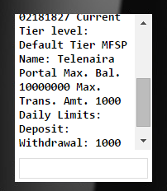
MANAGE MY ACCOUNT – Self Issue My Account
Remote account opening based on KYC already done by NGO and DFSP, no additional ID required
Alt ID assigned to allow multiple accounts on same phone and culturally appropriate alternative to phone number
Immediate PIN creation, no need to wait for SMS or enter activation codes

Slide 16
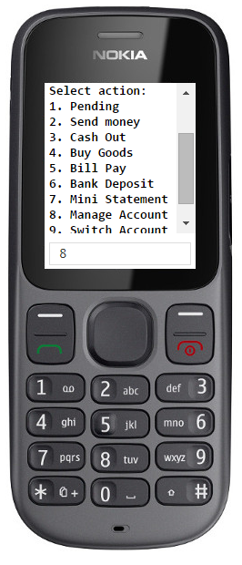
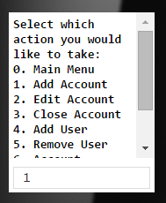
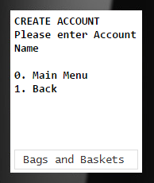
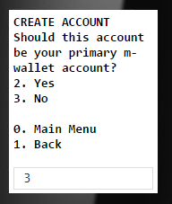
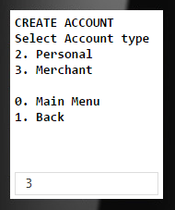
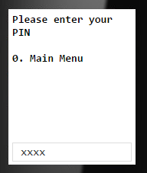
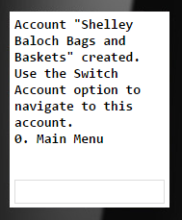
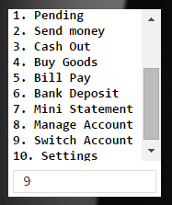
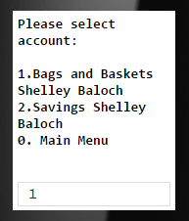
MANAGE MY ACCOUNT – Open a Sub-Account
User specifies the account name
Primary account status can be changed later
Anyone can create a merchant account
User can switch accounts from the main menu

Slide 17
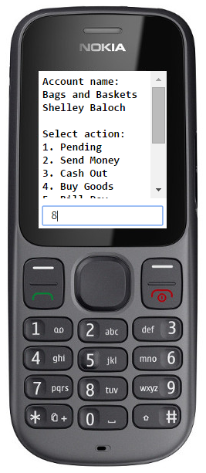
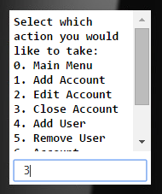
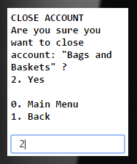
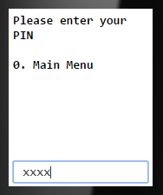
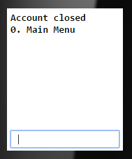
MANAGE MY ACCOUNT – Close a Sub-Account
An account may not be closed if it has a non-zero balance, or if it is a user’s primary account

Slide 18
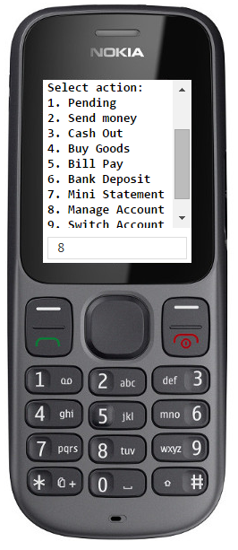
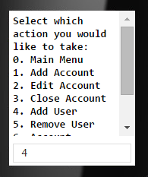
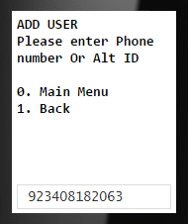
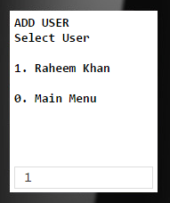
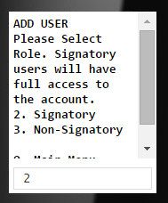
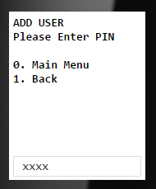
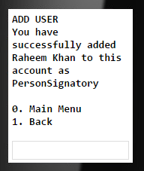
MANAGE MY ACCOUNT – Add a User
Identify the user to be added
SMS sent to Shelley (account owner) informing of new user added to account
Non-Signatory users are blocked from moving money out of the account
“Raheem Khan successfully added to m-wallet account Shelley Baloch mWallet with Alt ID 0000101471 as PersonSignatory.”

Slide 19
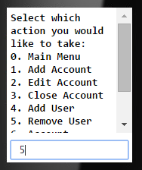
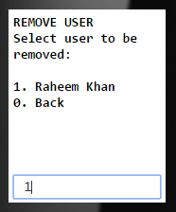
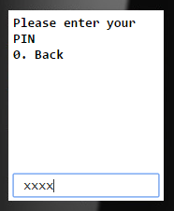
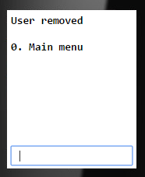
MANAGE MY ACCOUNT – Remove a User
User to be removed is selected

Slide 20
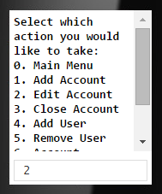
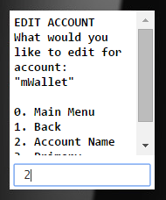
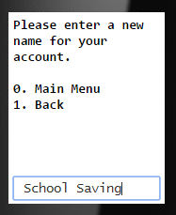
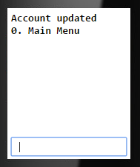
MANAGE MY ACCOUNT – Rename an Account
User can name the account anything

Slide 21
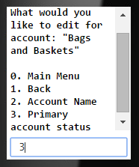
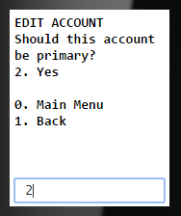
MANAGE MY ACCOUNT – Change Primary Account
The primary account will be transacted with when a person’s phone # is used.

Slide 22
SEND MONEY TO ANYONE
Send Money to Anyone

Slide 23
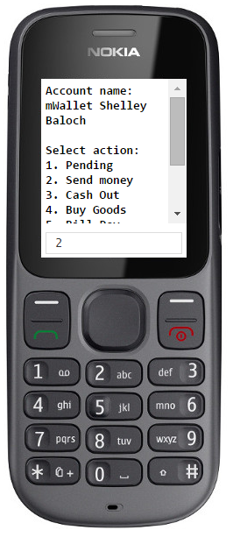
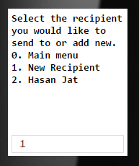





SEND MONEY TO ANYONE
System stores most frequent recipients to reduce data entry and reduce errors
Recipient’s name is shown to reduce errors
Fee is shown before transaction is finalized
Money can be sent to any user, regardless of which DFSP their account is on

Slide 24
MERCHANT TRANSACTIONS BY PAYMENT TYPE
Buy Goods – mWallet
Buy Goods – Voucher
ALTERNATE VALIDATION METHODS
Merchant’s Phone
POS
Biometric Verification

Slide 25












BUY GOODS – Validate on Customer Phone
Merchant initiates transaction
Merchant inputs customer phone # or Alt ID
Customer chooses to approve transaction via USSD method
If customer has valid voucher then Merchant is given option to accept Voucher or mWallet as payment type
Merchant waits for customer to approve via USSD
Customer selects from pending transactions
xxxx
Customer reviews amount and fees, approves with PIN

Slide 26







BUY GOODS – Voucher: Validate on Customer Phone
Merchant initiates transaction
Merchant inputs customer phone # or Alt ID
Customer chooses to approve transaction via USSD method
If customer has valid voucher then Merchant is given option to accept Voucher or mWallet as payment type
Merchant waits for customer to approve via USSD
Customer selects from applicable vouchers
DFSP has option to charge voucher handling fee in addition to mWallet fee
Customer reviews amount covered by voucher, selects method for paying remainder

Slide 27


BUY GOODS- mWallet: Validate on Merchant Device
Customer initiates transaction with Merchant
Merchant inputs customer phone # or Alt ID
Customer chooses to approve transaction via Phoneless method
Merchant hands smartphone to customer, customer enters PIN
Transaction clears immediately, sends SMS to customer, and Merchant releases goods to customer
“You have confirmed Alayna Bengial transaction for 100: 100 via mwallet plus fee of 0.2. RRN 2453”

Slide 28



BUY GOODS: Validate on Traditional POS Terminal
Merchant enters purchase amount into POS Device
User swipes NFC sticker or enters phone number or alt IT
User reviews transaction details and approves with PIN
Confirmation received on POS and receipt printed

Slide 29
KEEP MONEY SECURE
Check My Account Balance
Tier Limits
IST Checks and Balances
Fraud Check and Blacklist

Slide 30




KEEP MONEY SECURE – Check My Account Balance
Free mini statement shows current balance and recent transactions
Financial information kept secure behind PIN

Slide 31



KEEP MONEY SECURE – Tier Limits
Tiered transaction limits are set and monitored at the IST to reduce and manage system risk
Transaction amounts and counts are tracked at the person level (incoming and outgoing), and are monitored for multiple time periods
Local KYC regulations in addition to other factors can be used to define requirements for a user to be granted a higher tier

Slide 32

KEEP MONEY SECURE - IST Checks & Balances
Each DFSP maintains a record of their users’ transactions
IST maintains a record of all transactions, reducing risk of fraud at individual and organization level

Slide 33
KEEP MONEY SECURE – Fraud Check and Blacklist
Individuals can be screened for fraud at regular intervals
Blacklisting a user freezes their account and prevents further activity

Slide 34
AGENT TRANSACTIONS
NFC Registration
Biometric Registration
Cash In
Cash Out

Slide 35










AGENT TRANSACTIONS - NFC Registration
Customer tells agent they would like to purchase an NFC sticker
Agent enters customer’s phone # or Alt ID, confirms customer name
Agent scans a new NFC sticker with NFC-enabled smartphone that reads and logs serial number
Customer chooses to approve the transaction via USSD. SMS is sent to their phone.
Transaction record shown as ‘pending’ until customer approves.
“You have a pending NFC Activation transaction from Alayna Bengial for a fee of 3.00. Total transaction amount: 3.00”
Agent gives NFC sticker to customer

Slide 36








AGENT TRANSACTIONS – Biometric Registration
Customer requests Bio Enrollment
Agent reviews identification card, submits customer info
Bluetooth fingerprint scanner is used
Customer photo is stored at the system level for display during bio-approved transactions

Slide 37




AGENT TRANSACTIONS – Cash In
Customer verbally initiates Cash In transaction, hands cash to agent
Agent enters customer info and submits Cash In transaction
Agent’s mWallet is debited. Agent receives commission amount set by DFSP.
Customer receives SMS confirming Cash In transaction was completed.
“Your account was credited from Alayna Bengial with amount of 500. RRN 2595”

Slide 38








AGENT TRANSACTIONS – Cash Out
Customer verbally initiates Cash Out transaction with Agent
Customer has photo in system from biometric registration
Agent shows screen to customer for amount and fee confirmation
Agent scans customer’s finger
Agent hands cash to customer
Agent’s mWallet is credited. Agent receives commission amount set by DFSP.

Slide 39
AGENT MANAGEMENT
Cash Request
Float Management
Agent Network / Dashboard

Slide 40

AGENT MANAGEMENT – Agent Network Dashboard
Agent manager hierarchy is viewable
Liquidity of individual agents or average of the network
Float loan provider can review and approve agent requests
Link to Float Request
Agent network performance can be assessed through summary KPIs
Link to Cash Request
Cash manager can review and approve agent requests

Slide 41




AGENT MANAGEMENT – Cash Request
Agent determines on-hand cash amount is too low, initiates Cash Request
Agent selects ‘disbursement’
Request is pending until Cash Manager dispatches courier to Agent’s location
Link to Dashboard

Slide 42





AGENT TRANSACTIONS – Agent Float Management
Agent determines float balance is too low
Agent specifies requested float loan amount
Available float providers are presented with associated fees and interest amounts
Agent selects a float provider
Float loan request is pending until float provider approves
Link to Dashboard

Slide 43
END

Slide 44
Bulk Payment – IST Requirements – Pg 33 & 34
The IST shall support a mechanism enabling individual transactions to be tracked to a parent batch group.
Rationale: While the core IST may not decompose the payment batch or specifically report the aggregate response/health of the batch, it needs to retain the association between the batch and the individual transaction in some way. This association may be directly supported by attaching an identifier tag provided by the batch processor, or indirectly by responding to each payment message with the unique transaction ID, with the batch processor being responsible for associating the transaction ID with the batch.
The IST shall confirm the payer settlement account has sufficient funds to meet the maximum potential cumulative payout of the contained individual beneficiary benefits or the defined maximum for the total batch.
Rationale: Ensuring the payer has sufficient funds is a primary pre-condition in any push payment.
The IST shall reject component transactions where named participants are ineligible to transact.
Rationale: Payments must be subject to fraud and AML/CFT checks, and blocked where the participant is deemed an unacceptable recipient. www.gatesfoundation.org Requirements for a Pro-Poor Interoperability Service for Transfers
The IST shall reject any component transactions contained within the bulk payment file that do not include the minimum required data fields.
Rationale: Incomplete records must be rejected to enable resolution by the payee.
The IST shall reject any component transaction contained within the bulk payment file if the beneficiary phone number or account number is unassigned or not valid.
Rationale: This would likely be due to incorrect information, and would require correction and resubmission by the payer.
The IST shall reject any component transaction contained within the bulk payment file if the beneficiary identity fails validation (e.g., name and national ID do not match)
Rationale: This would likely be due to incorrect information, and would require correction and resubmission by the payer.
The IST shall retry distribution of any component transactions contained within the bulk payment file on a defined retry period or when the failure condition is resolved, if it failed because: a. No mobile wallet account is associated with the phone number. b. The DFSP was not reachable. c. There were other recoverable errors that do not require changes to the submitted information.
Rationale: Defining a retry period allows for automatic completion or improved distribution where the reason for failure can be corrected (e.g., beneficiary signs up for a mobile wallet upon notification of available benefit, a DFSP comes back online)
The IST should have a minimum retry time. (e.g., no less than 15 minutes).
Rationale: High-frequency retries could degrade or overload processing capability without a defined and enforced safe floor limit.
The IST should enable a system administrator to manually retry or trigger distribution.
Rationale: There will likely be processing scenarios (e.g., one DFSP is unavailable) that require manual intervention to clear backlogged transactions.
The IST shall discontinue retries when a defined maximum retry limit is reached or processing completes successfully.
Rationale: If there were no retry limit, failed transactions could increase forever, potentially consuming enough system resources to degrade or prevent transaction delivery.

Slide 45
Bulk Payment Tests – End to End
Maker (uploader)
Maker role has ability to upload bulk payment file
File format checked at upload
incorrect file type (jpeg, executable)
"Good" file is uploaded
Duplicate status is checked
Maker can view newly uploaded bulk payment
Ability to use person's phone number or Alt ID
Maker does not have ability to send bulk payment file
Maker has ability to delete bulk payment file
Checker (sender)
Checker cannot upload bulk payment file
User can access newly uploaded bulk payment file
Bulk payment file can be sent
Ability to send funds to person without account
Bulk Payment Report can be veiwed
Total transaction count by type total transaction value is shown in report header
Expiration date is shown for all pending payments
Appropriate error description are shown for each failed payment row
Payment to blacklisted recipient is blocked
Funds transfer to recipients
Payment withdrawn if expiration date is passed
G2P amount limits are active
For sender (organization)
For recipient (person)
Sufficient funds checked

Slide 46
Bulk Payment API
● Method Name - bulkPayment
● Method Description - Bulk payment batch job used by organizations to process multiple payments at once.
Request Format
{
"jsonrpc":"2.0",
"id":"...",
"method":"ist.bulkPayment ",
"params":{
" participantid ":"...",
" batchname ":"...",
" batchid ":"...",
" payments ":[
{
" beneficiaryid ":"...",
" firstname ":"...",
" lastname ":"...",
" birthdate ":"...",
" nationalid ":"...",
" phonenumber ":"...",
" amount ":"...",
" expiredate ":"..."
},
{...}
]
}
Request params
participantid (mandatory) ID of the organization (table Participant)
batchname (mandatory) The name of batch.
batchid (mandatory) The id of batch.
payments (mandatory) An array of payment objects
beneficiaryid (mandatory) Beneficient's registration identifier
firstname (mandatory) Customer first name (see Registration table)
lastname (mandatory) Customer last name (see Registration table)
birthdate (mandatory) Customer date of birth (see Registration table)
nationalid (mandatory) National identifier of the customer
phonenumber (mandatory) Phone number
amount (mandatory) The amount of payment
expiredate (mandatory) To date which can use this payment
Successful response
{
"jsonrpc":"2.0",
"id":"...",
"success":"true",
"result": {
" bulkPaymentId ":"..."
}
}
Successful response properties
bulkPaymentId - The newly generated identifier of the processed bulk batch
Error response
{
"jsonrpc": "2.0",
"id": "...",
"success": "false",
"error": {
" code ": "...",
" message ": "..."
}
}
Error response properties
code - Error code
2001 – SQL Error
message – Error message

